Slide 1

Medicaps university
PROJECT PRESENTATION
ON
SENTIMENT ANANLYSIS OF REVIEWS USING NATURAL LANGUAGE PROCESSING
Presented By:
Siddhesh Gupta (EN16CS301262)
Shruti Mundi (EN16CS301252)
Vaishnavi Meharwal (EN16CS301282)
Varun Gokhale (EN16CS301283)
Internal Guide :
Prof. (Dr.) Ruchi Patel
Prof. Sachin Solanki
External Guide:
Dr. Ravi Changle

Slide 2

SENTIMENT ANALYSIS OF REVIEWS USING NATURAL LANGUAGE PROCESSING

Slide 3

Tata consultancy services
Tata Consultancy Services Ltd is a leading global IT services, consulting and business solutions organization. The company offers a range of IT services, outsourcing and business solutions. They also offer IT infrastructure services, business process outsourcing services, engineering and industrial services, global consulting and asset leveraged solutions. Their segments include banking, financial services and insurance; manufacturing; retail and distribution, and telecom.
The company is a part of Tata Group, one of India's most respected business conglomerates and most respected brands. They are headquartered in Mumbai. They are having 142 offices in 42 countries as well as 105 delivery centers in 20 countries. The company shares are listed on the National Stock Exchange and Bombay Stock Exchange of India.

Slide 4

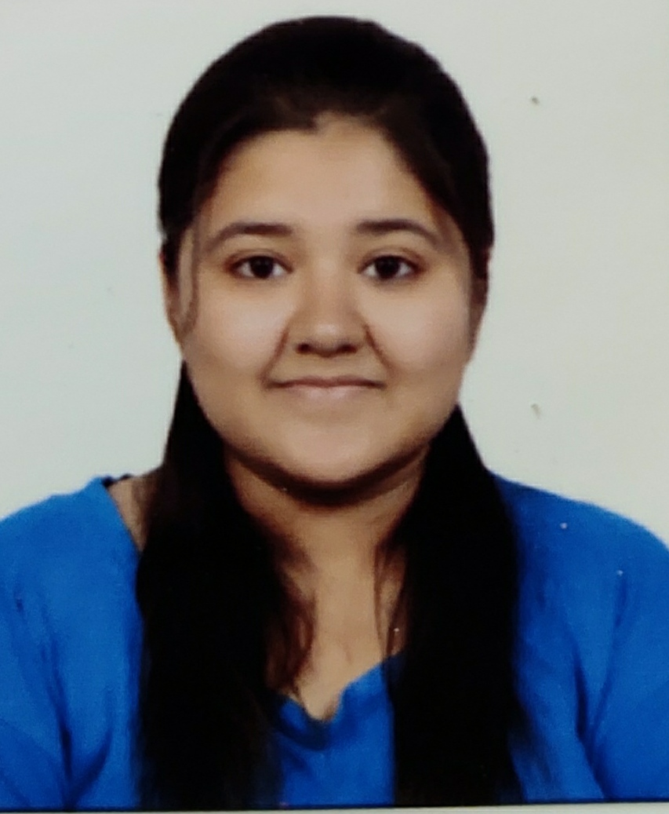
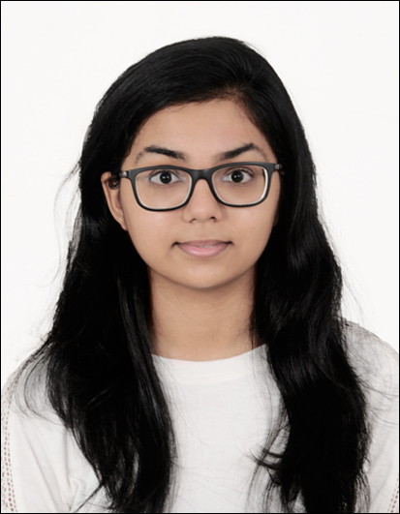
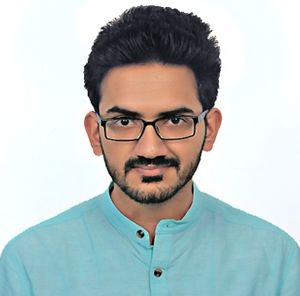
S
S
V
Siddhesh Gupta
Shruti Mundi
Vaishnavi Meharwal
Varun Gokhale
Workdone
Flask development and deployment, Data Preprocessing, model building and accuracy improvement
Workdone
N-Gram Model Generation,
Model Building and accuracy improvement
Workdone
LDA Model Generation, research paper study, documentation, Model Building and accuracy improvement
Workdone
Balancing of data, Data Preprocessing and Visualizations, Deep learning model implementation
Azure development

Slide 5
Problem statement
Travel planning and hotel booking on website has become one of an important commercial use. Sharing reviews on web has become a major tool in expressing customer thoughts about a particular product or Service. Recent years have seen rapid growth in collecting customer reviews through the internet.
A crucial characteristic of a customer’s review is their sentiment or overall opinion — for example if the review contains words like ‘great’, ‘best’, ‘nice’, ‘good’, ‘awesome’ is probably a positive comment. Whereas if reviews contains words like ‘bad’, ‘poor’, ‘awful’, ‘worse’ is probably a negative review.
We seek to turn words and reviews into quantitative measurements. We extend this model with a supervised sentiment component that is capable of classifying a review as positive or negative with accuracy

Slide 6
OBJECTIVE
We consider the problem of classifying a hotel review as positive or negative and thereby analyzing the sentiment of a customer. In this project, we build a system which is able to perform sentiment analysis of the review and use it to the customer satisfaction.
Customer reviews on social media websites reflect the customer's opinions concerning various aspects of the hotel’s place or service (e.g., “comfortable room” and “terrible service”). In this project, we determine the positive and negative aspects of the hotel services from the text reviews.

Slide 7
workflow
Data Gathering (data taken from Kaggle)
Data Analysis
Data Preprocessing and Data Visualization
Model Selection
Model Refining
Results
[1] kaggle 515k-hotel-reviews-data-in-Europe
[2] Research paper
[3] Visualizations
[4] Preprocessing
[5] Model Selection
[6] Model Refining

Slide 8
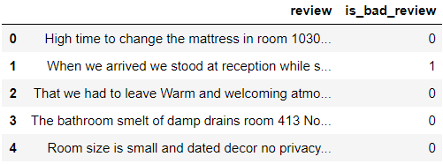
Data set
Reviewer_Score > 5 → Positive Review (0)
Reviewer_Score < 5 → Negative Review (1)
dataset

Slide 9
Data set taken from Kaggle
(515K Hotel Reviews)
Preprocessing data:
removing punctuations, removing digits,
removing empty tokens, removing stop words, removing one letter words, POS tagging and lemmatization
Selecting the Model
(Logistic Regression)
Transforming the dataset to balanced dataset containing 20K Hotel Reviews
Improving the Accuracy of the Model
By applying Hyperparametric Tuning
Selecting Features and adding features based on requirements
(review → pos+neg)
(is_bad_review → 0 if review_score>5 else 1)
Applying Sentiment Vader to the data
Applying the PCA Model to TF-IDF matrix for increasing accuracy
Applying TF-IDF model to the data
Visualizing the data for understanding
(made countplots, barcharts and piecharts for understanding feature dependencies)
Using Deep Learning, Artificial Neural Network (ANN) to increase the accuracy
Applying different machine learning models for checking accuracy

Slide 10
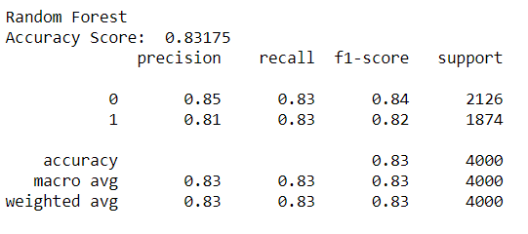
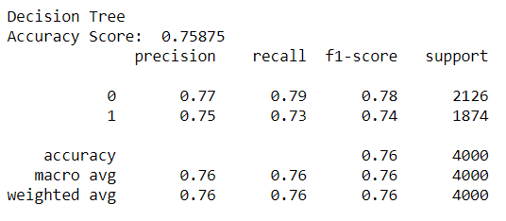
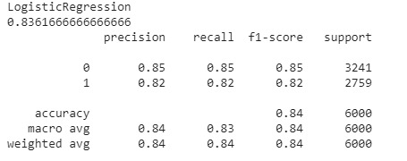
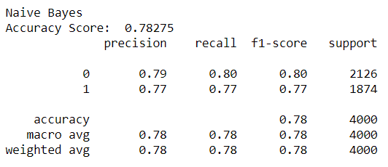
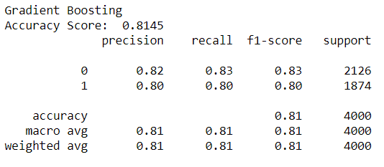
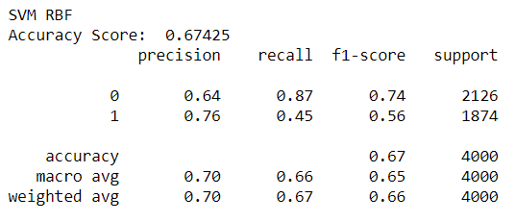

Slide 11
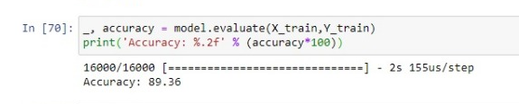
Accuracy of the Artificial Neural Network model

Slide 12
RESULTS
Model | Accuracy
RBF SVC | 67
Decision Tree | 75
Naïve Bayes | 78
Gradient Boosting | 81
Random Forest | 83
Logistic Regression | 84
Artificial Neural Network | 89

Slide 13
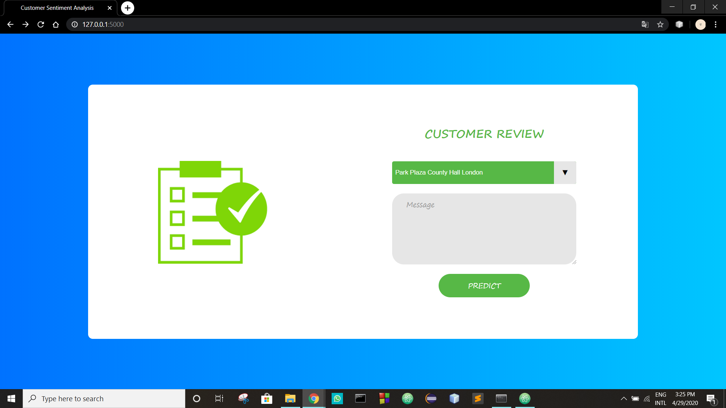
Web App

Slide 14
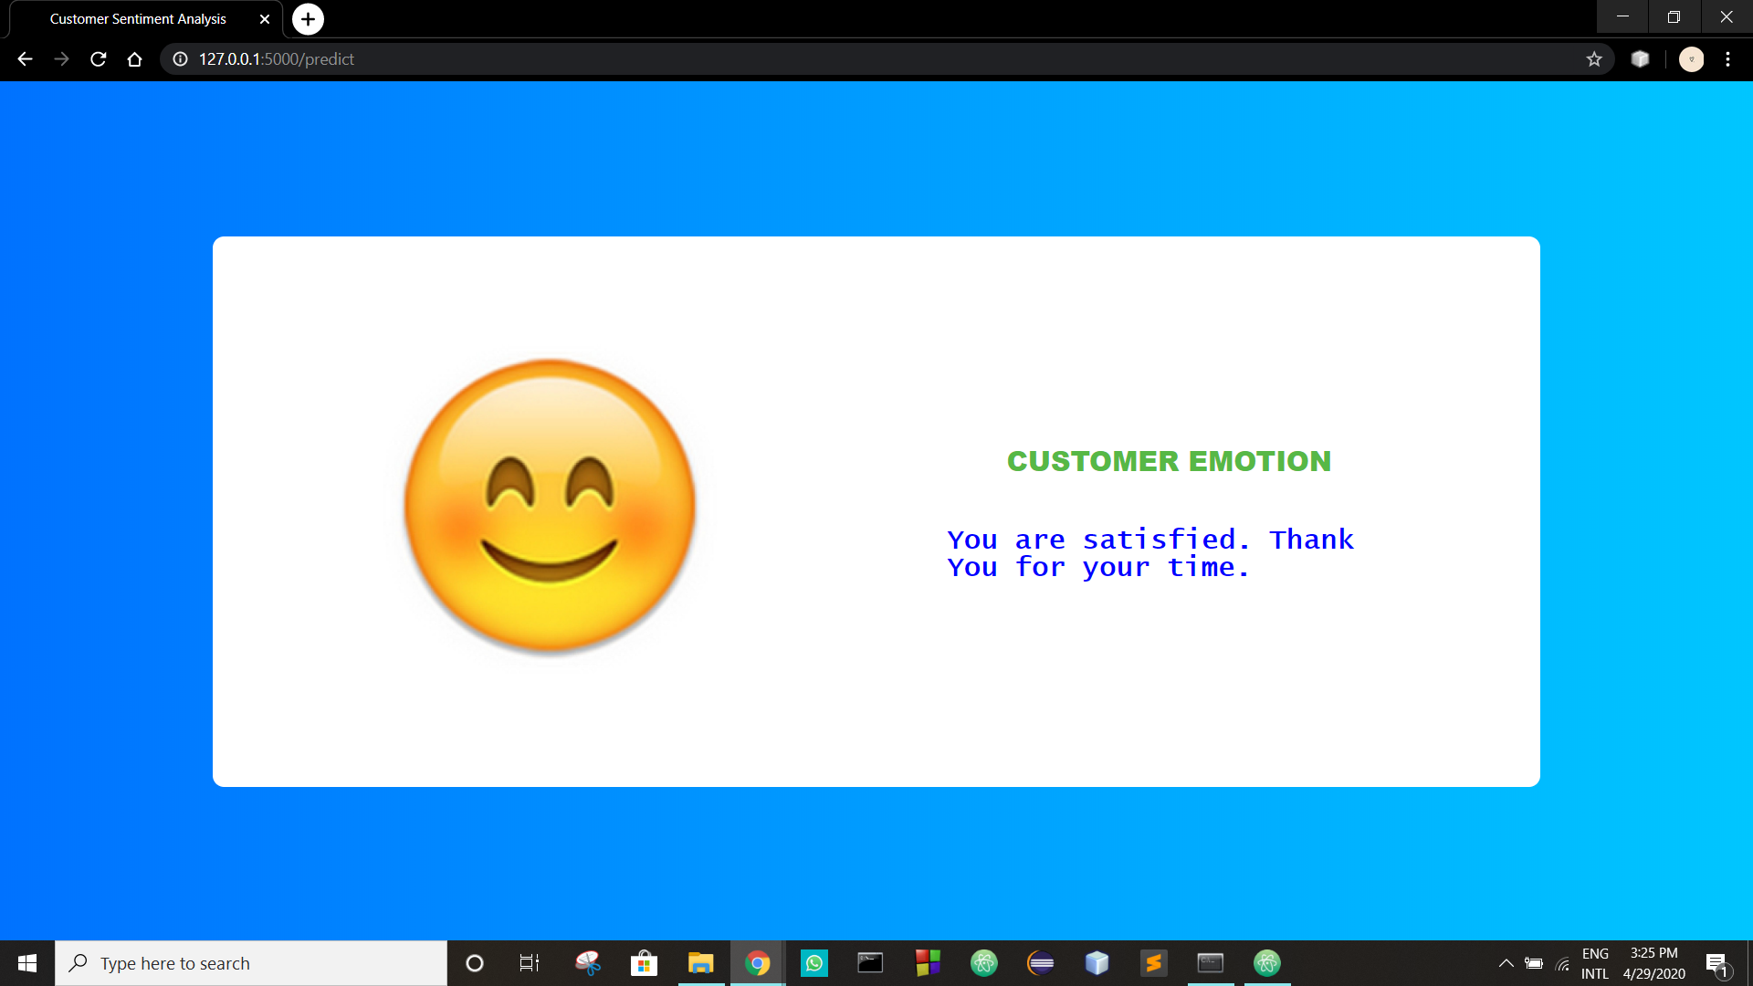

Slide 15
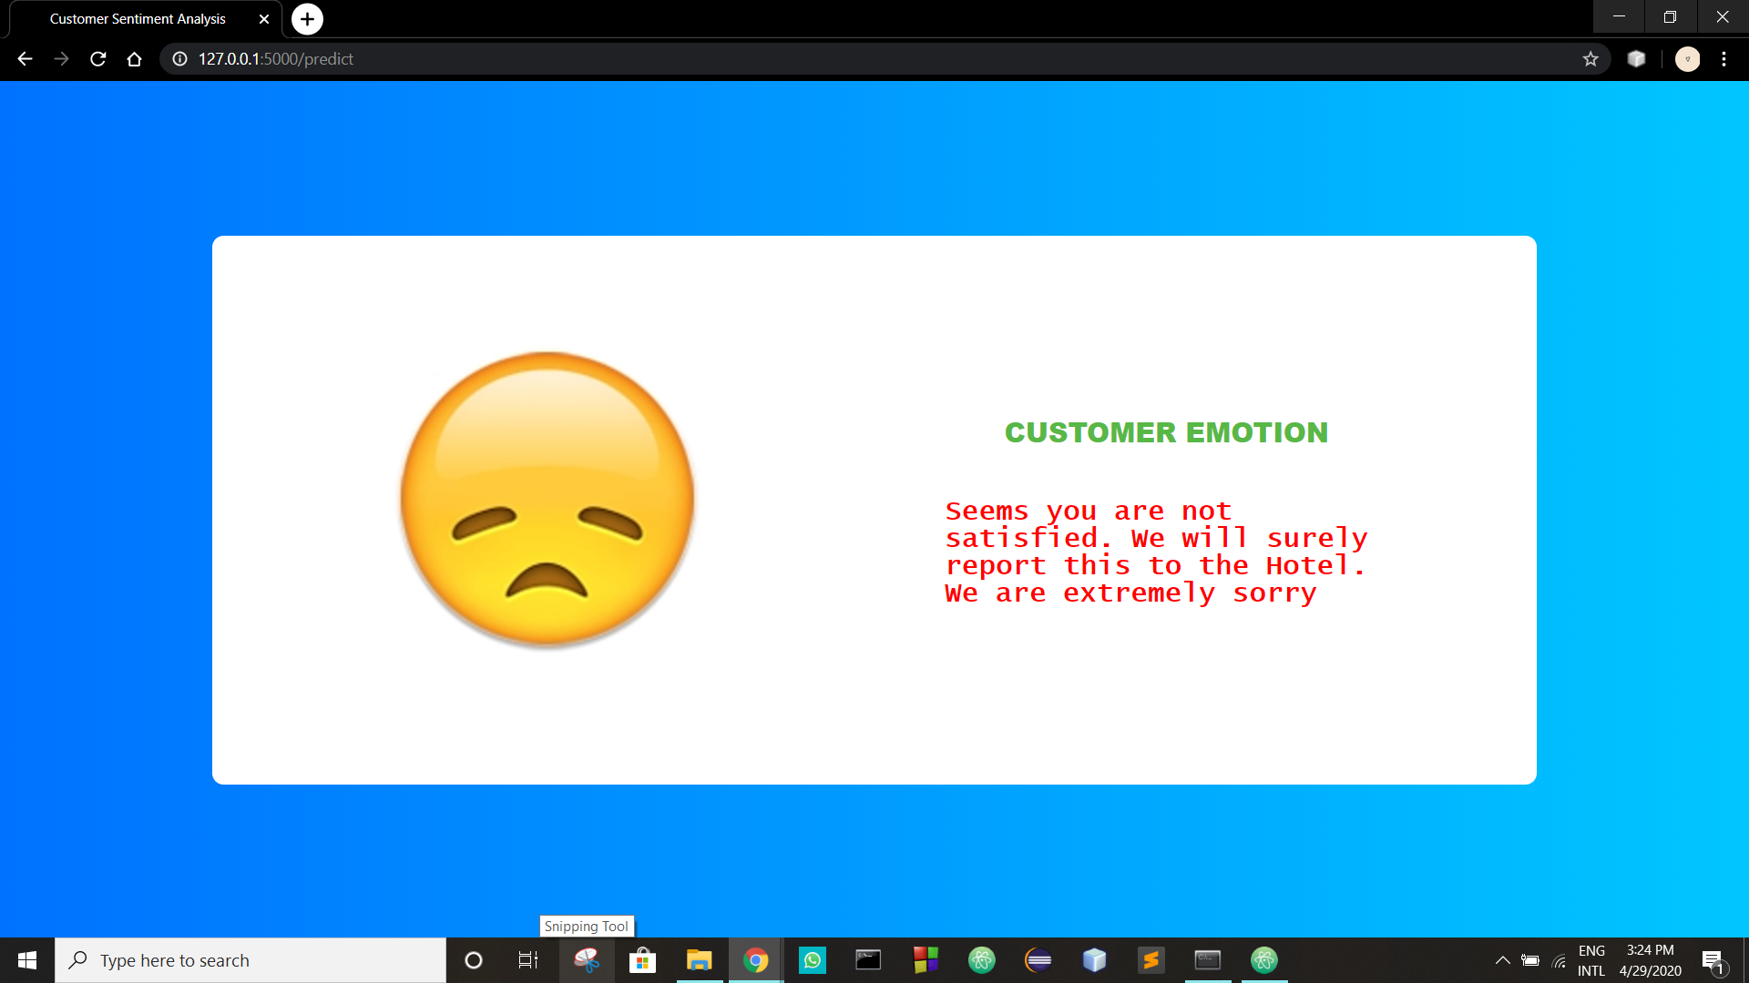

Slide 16
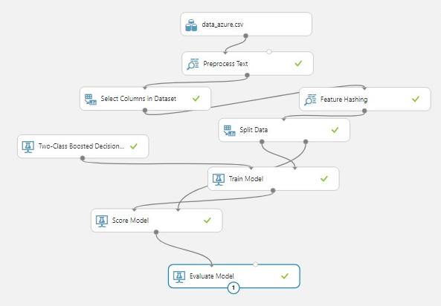
Web service
Azure workouts

Slide 17
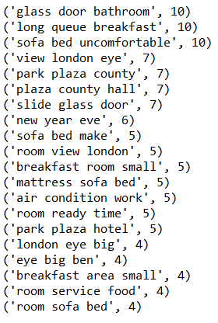
DETERMINING THE negative ASPECTS OF THE HOTELS
We have made an N-gram model to predict the top 10 negative qualities of a hotel.
Tells us that the Breakfast queue is long
Python-workout

Slide 18
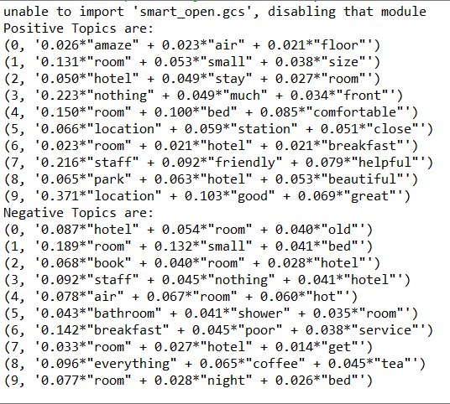
Topic modelling
We have used LDA (Latent Dirichlet Allocation) model to predict the topics of the review.
The topic thus generated can than be used to recommend hotels to a user based on his previous reviews.
TOPIC → STAFF
Python-workout

Slide 19
FUTURE SCOPE
Using the approach of LDA we can apply topic modelling on the hotels to recommend hotels to the users based on certain characteristics.
On the basis of the opinions of the customer we can make a rating system to rate the hotel making the rating universal rather than customer based.

Slide 20
MANAGERIAL IMPLEMENTATION
It can be used as a hotel recommendation system to recommend hotel’s to customers based on customer reviews.
The hotel management can use the system to find out the negative and positive services of the hotel based on reviews and thus improve the said services.

Slide 21
Thank you

